Slide 1
J2 Innovations’ Automatic RFID Employee Clocking System
Koppany Horvath’s Senior Project

Slide 2


Intro
Koppany Horvath
J2 Innovations
J2 Innovations is a start-up innovating in the field of data visualization for building automation systems (BAS). Our goal is to enhance the way humans interact with the connected world.
Jr. Developer / Linux guy / Hardware manager

Slide 3
Abstract
The purpose of this project is to design and implement an RFID based employee time tracking system for J2 Innovations, a building automation software company. The following hardware technologies were used: IOT enabled ESP32 microcontroller, RFID scanner module, 3D printing, WiFi AP device configuration. In addition, a variety of software was used: Arduino IDE, NodeJS framework, Ractive library, AM Charts library, MySQL database. The user experience was greatly improved and user complaints were reduced to nearly none. Possible future expansions include handling different time zones for international employees, generating reports and charts for management, and scheduling days off and vacations through the UI.

Slide 4

Initiation
Background of company
Use Toggl to track employee work hours
Recognize the problem
Current system is paid and closed source
Management can’t see employee schedules
Too easy to modify past data
Why did I select this project?
Both management and employees wanted it
Who are the end users?
All employees at J2 HQ in California

Slide 5
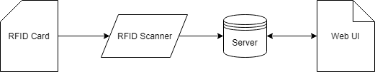
Development
Feasibility of project
Defined scope feasible within deadline
Design of the project

Slide 6
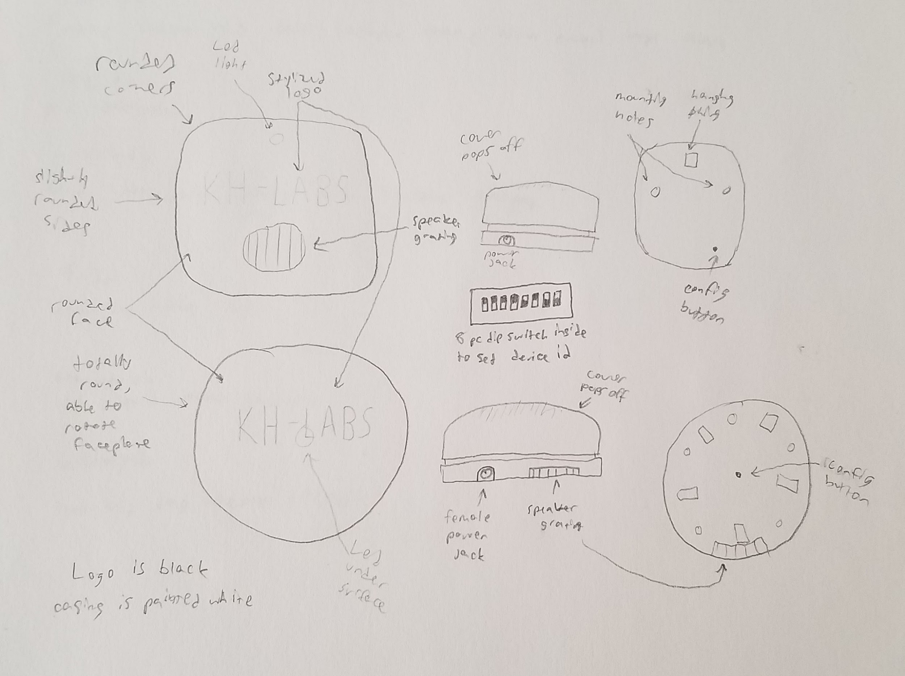
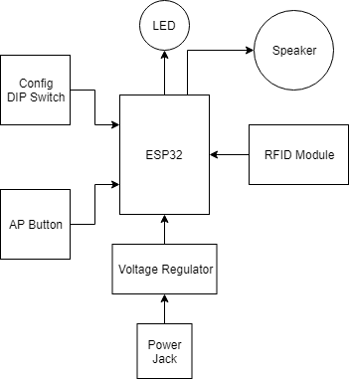
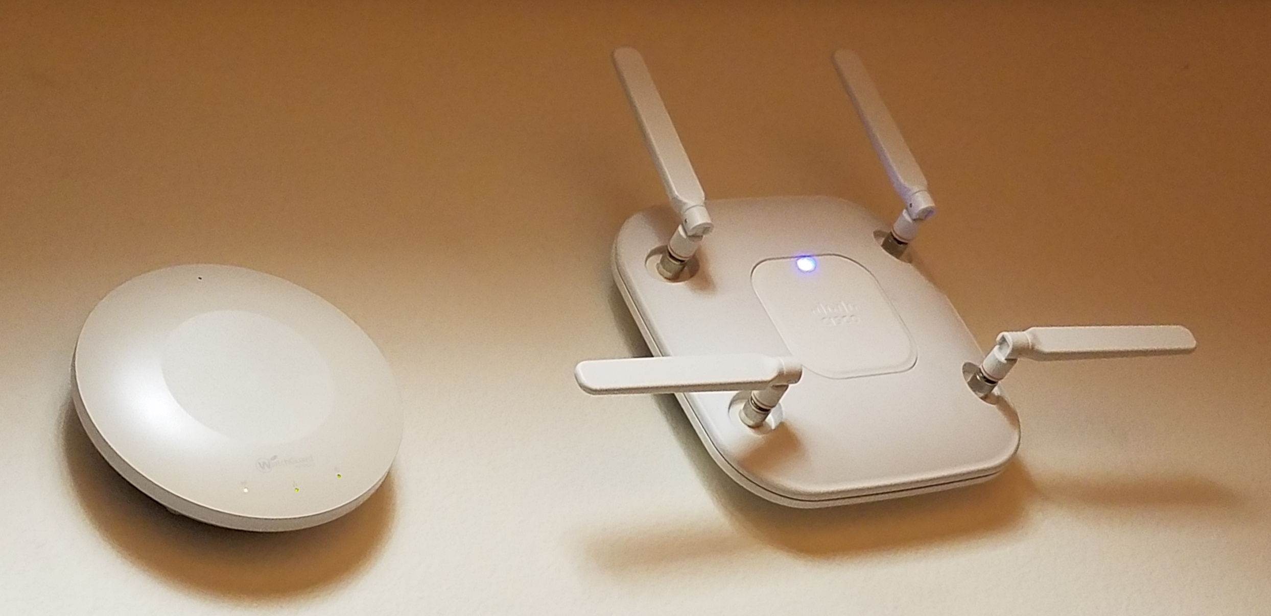
Development
Database Design
User Table
Project Table
Work Table
RFID Event Table
RFID Node Table
Clock In/Out Table

Slide 7
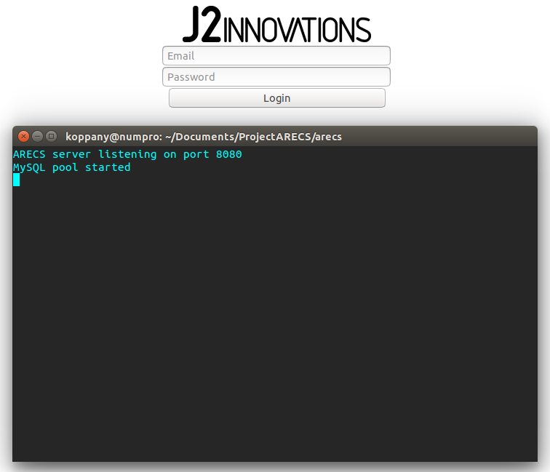
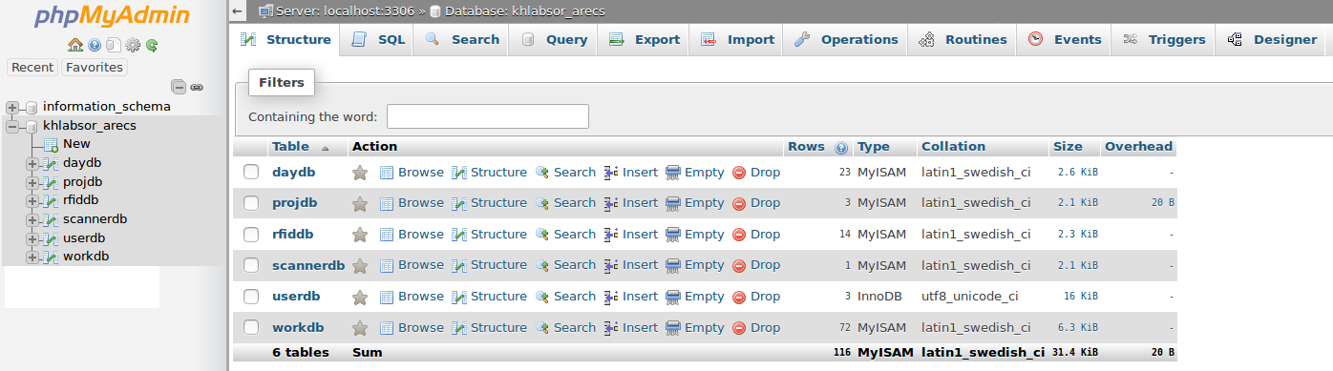
Implementation
Simple login page
Simple web server
First version of database

Slide 8
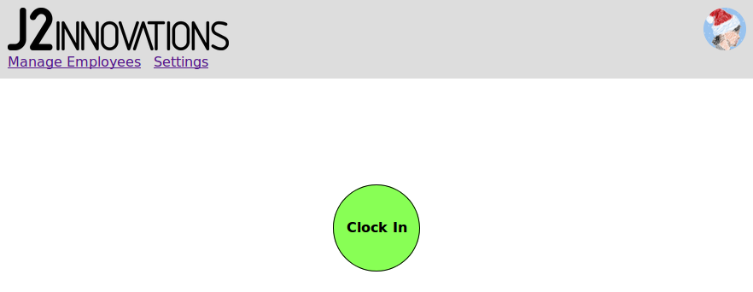
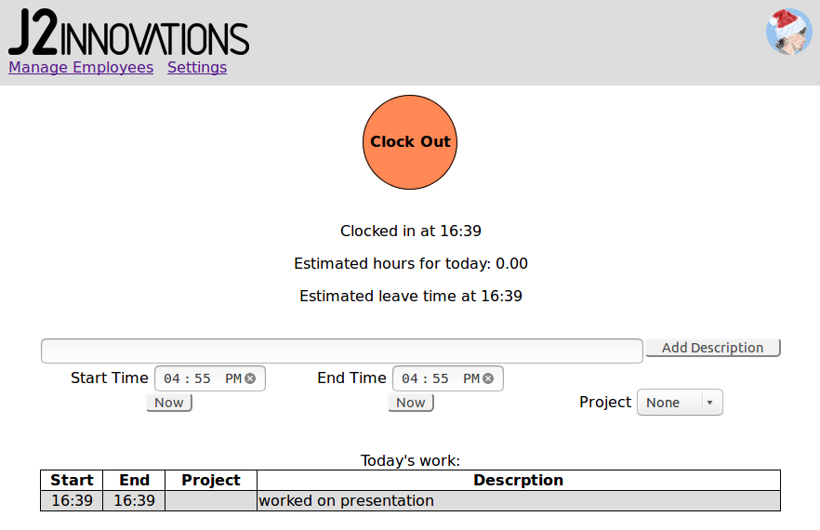
Implementation
Clock in/out page
Updates to server API
Updates to database

Slide 9
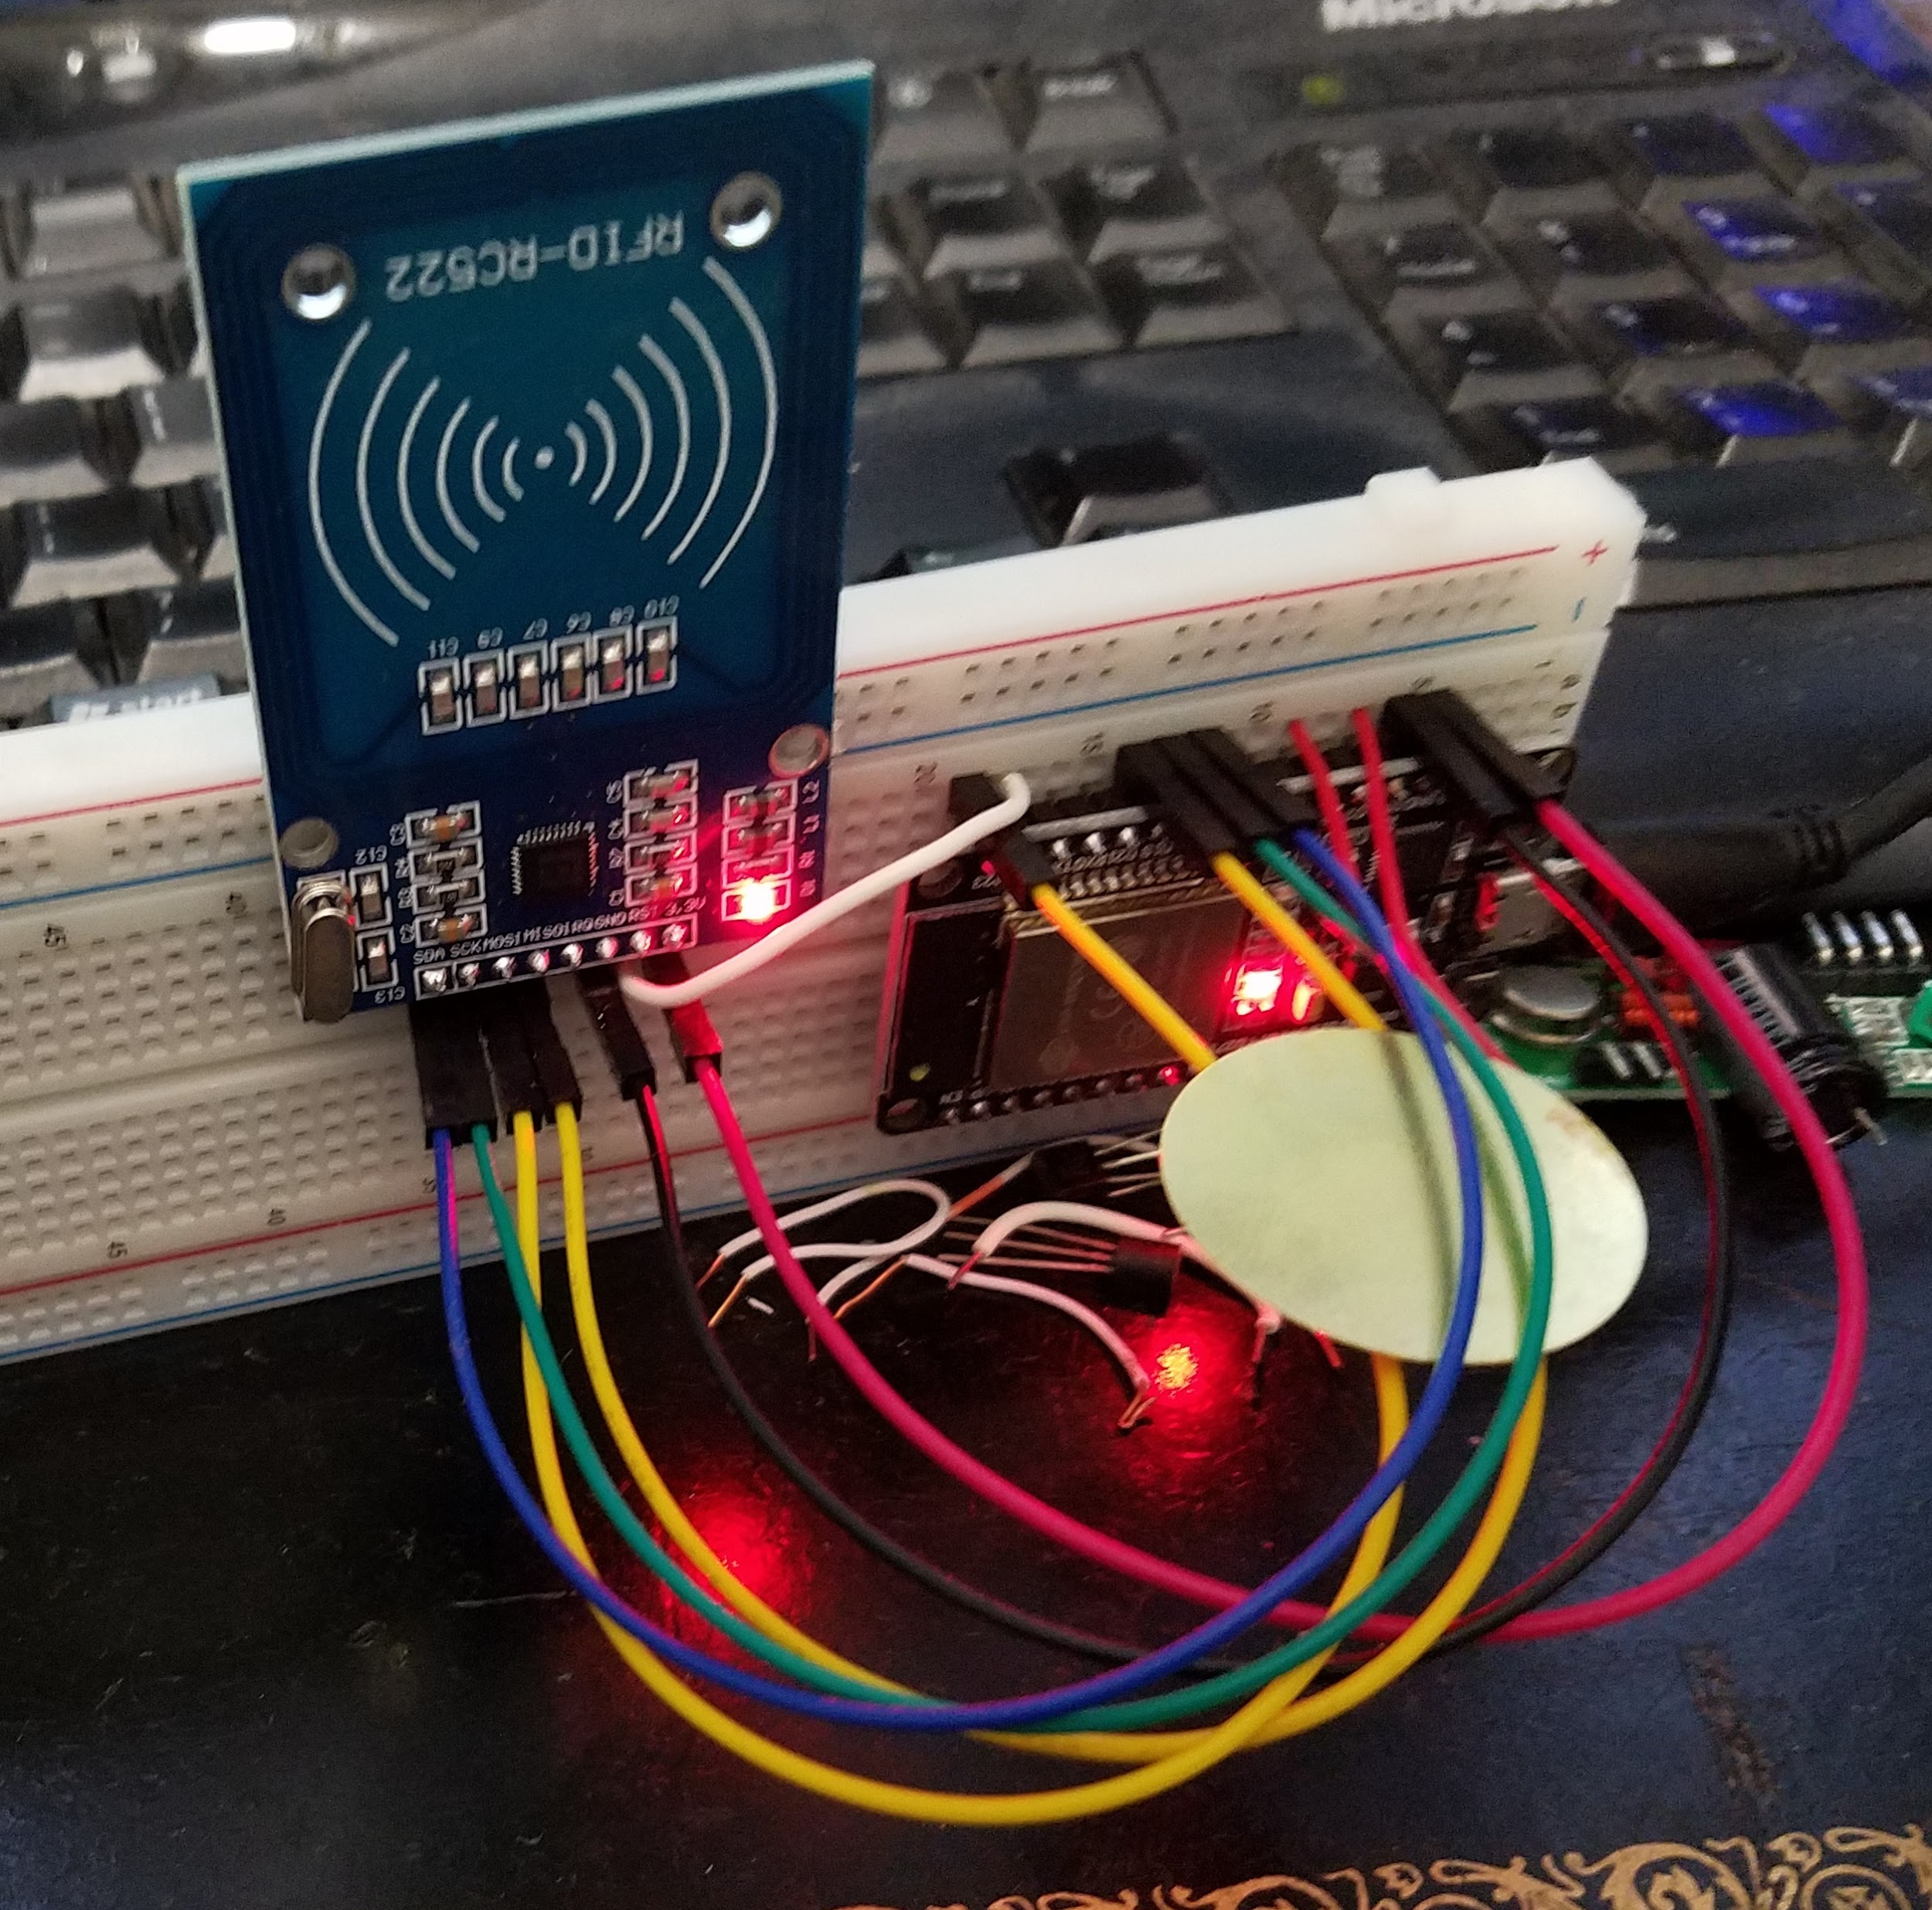
Implementation
Switching over to hardware
Test MCU
Test WiFi capabilities
Test RFID module
Test sound

Slide 10
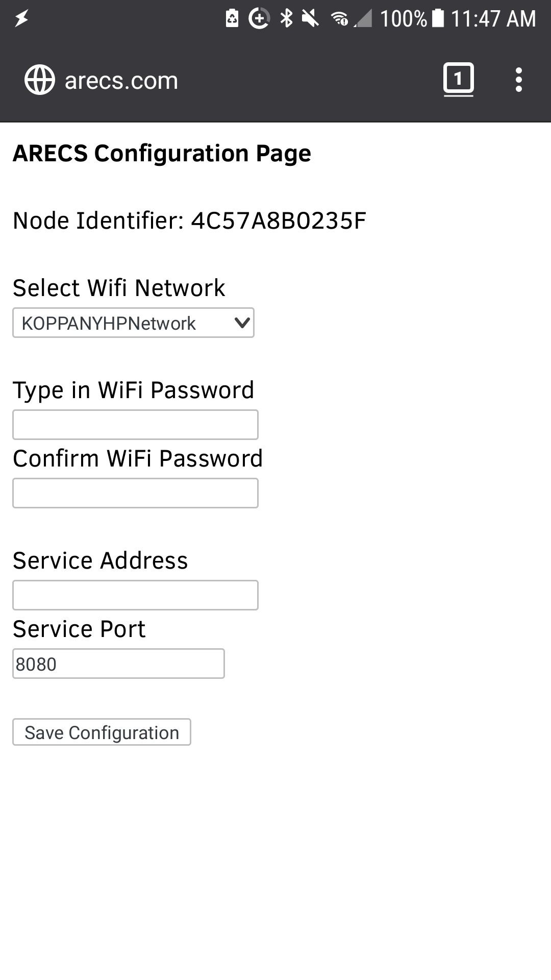
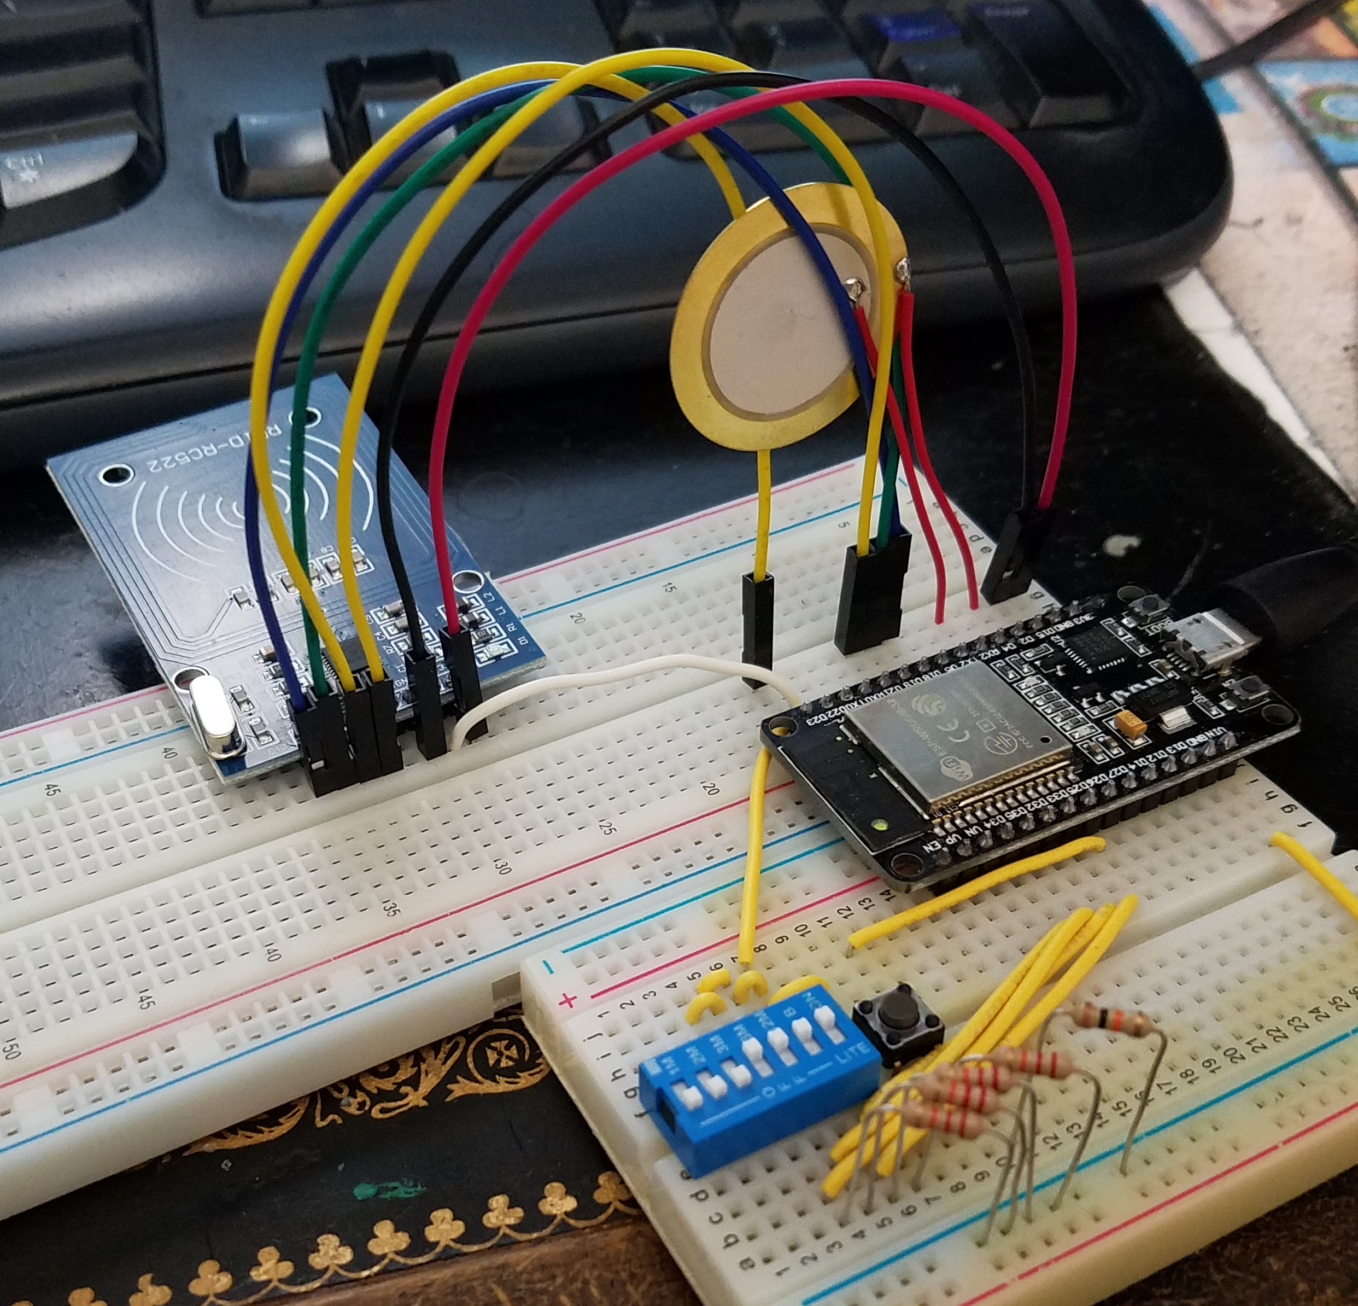
Implementation
Build the full circuit
Write AP routines
Write rest of firmware
Test all modes
Test all features
Update server API
Updates to database

Slide 11
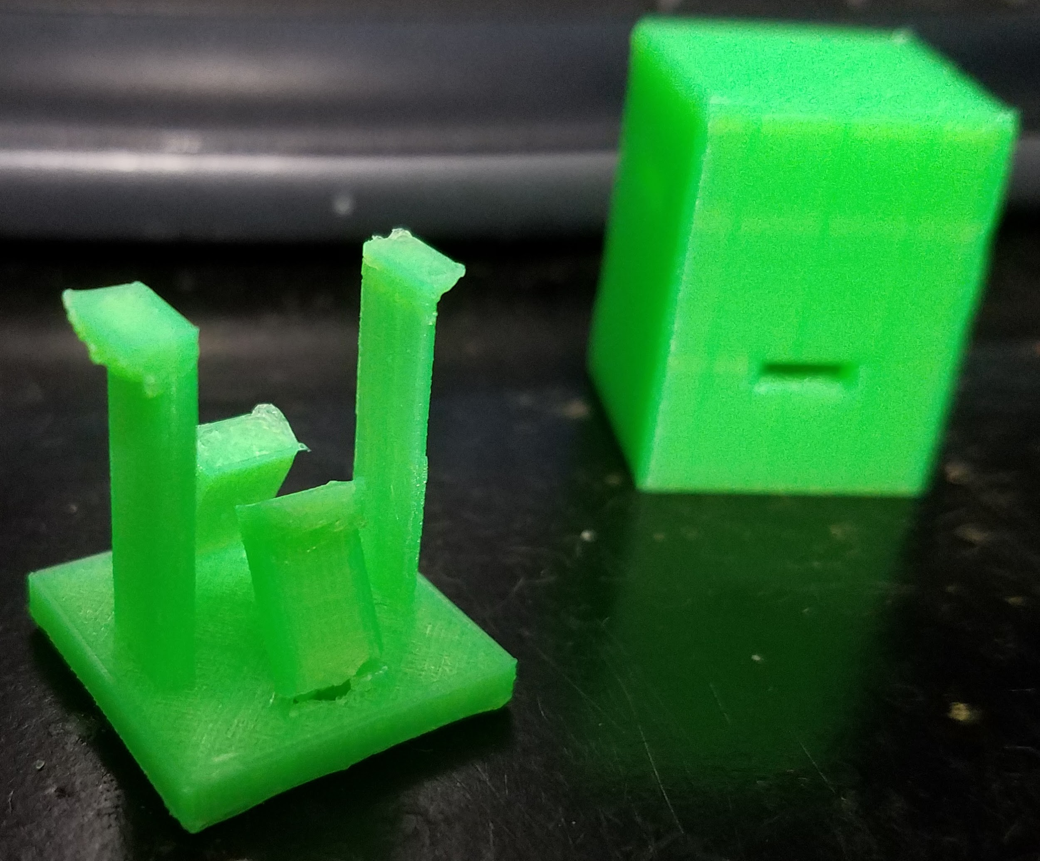
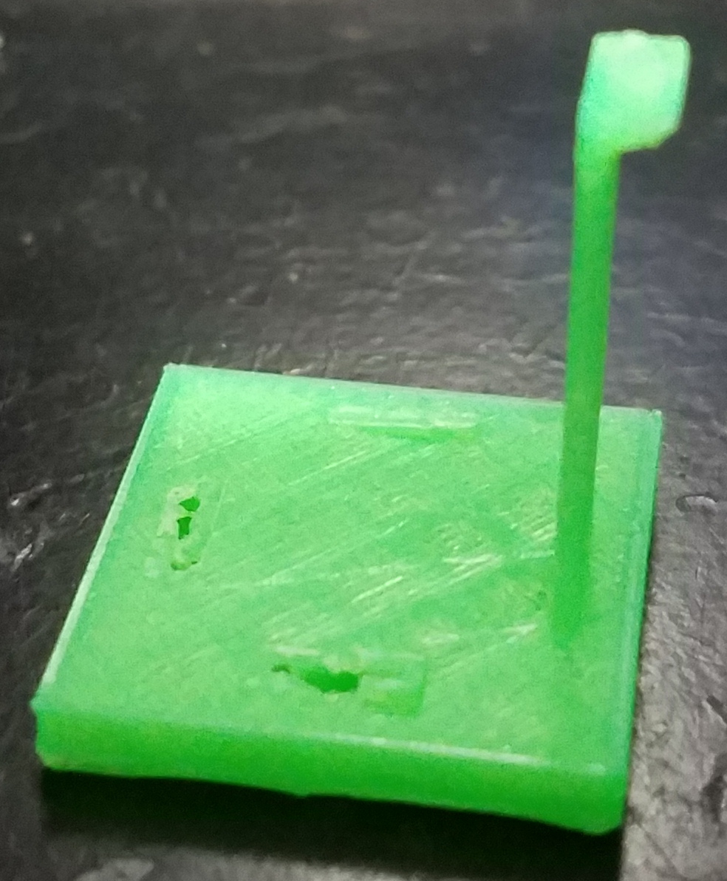
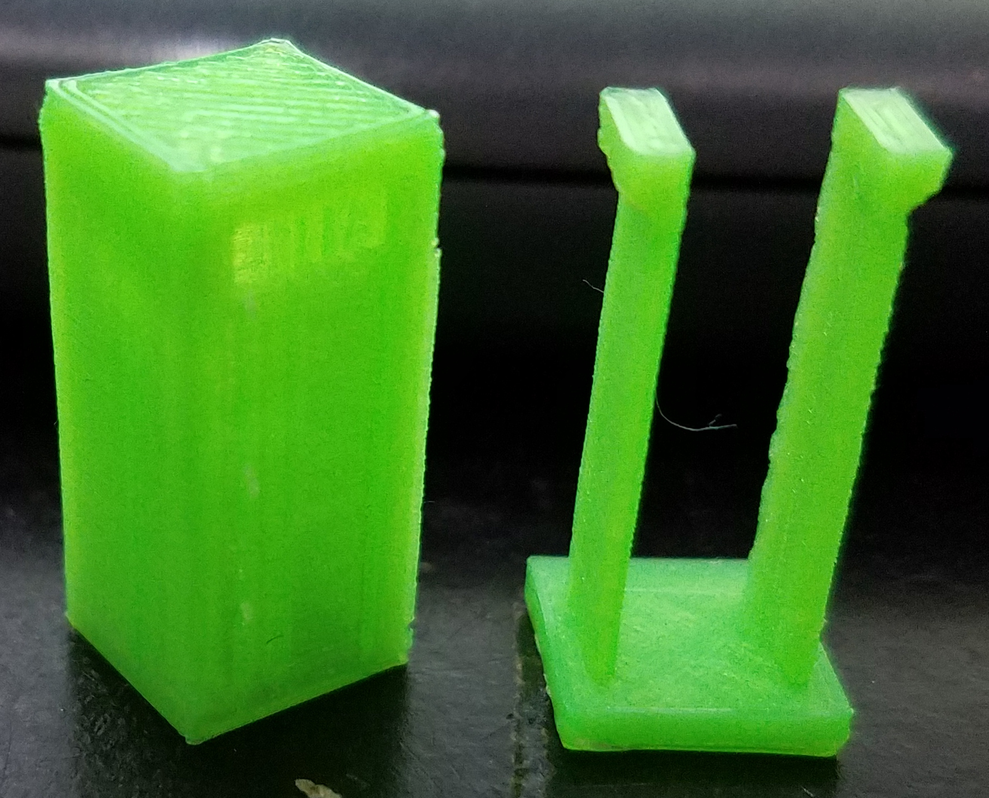
Implementation
3D printed case design
Using snap joints
Trial and error
Alternative needed

Slide 12
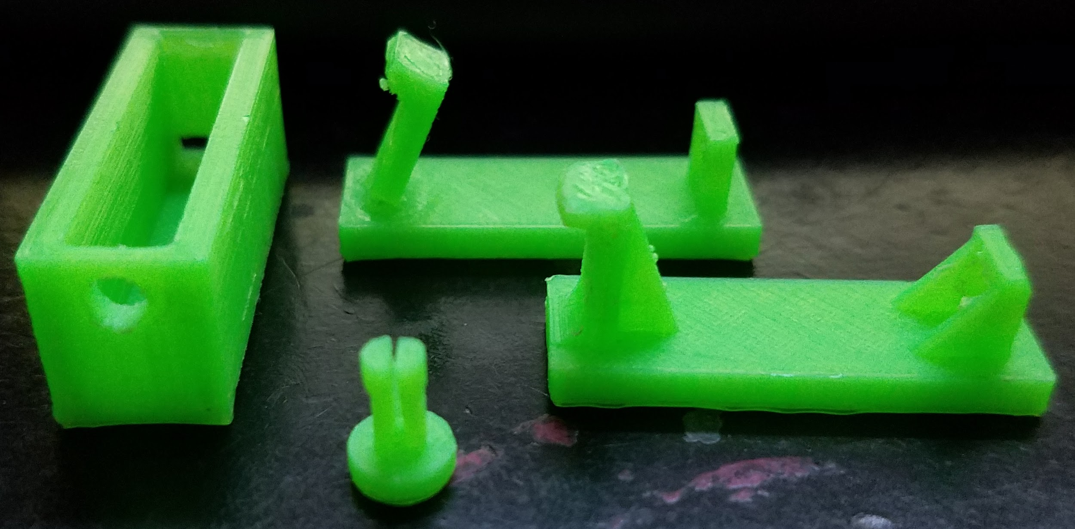
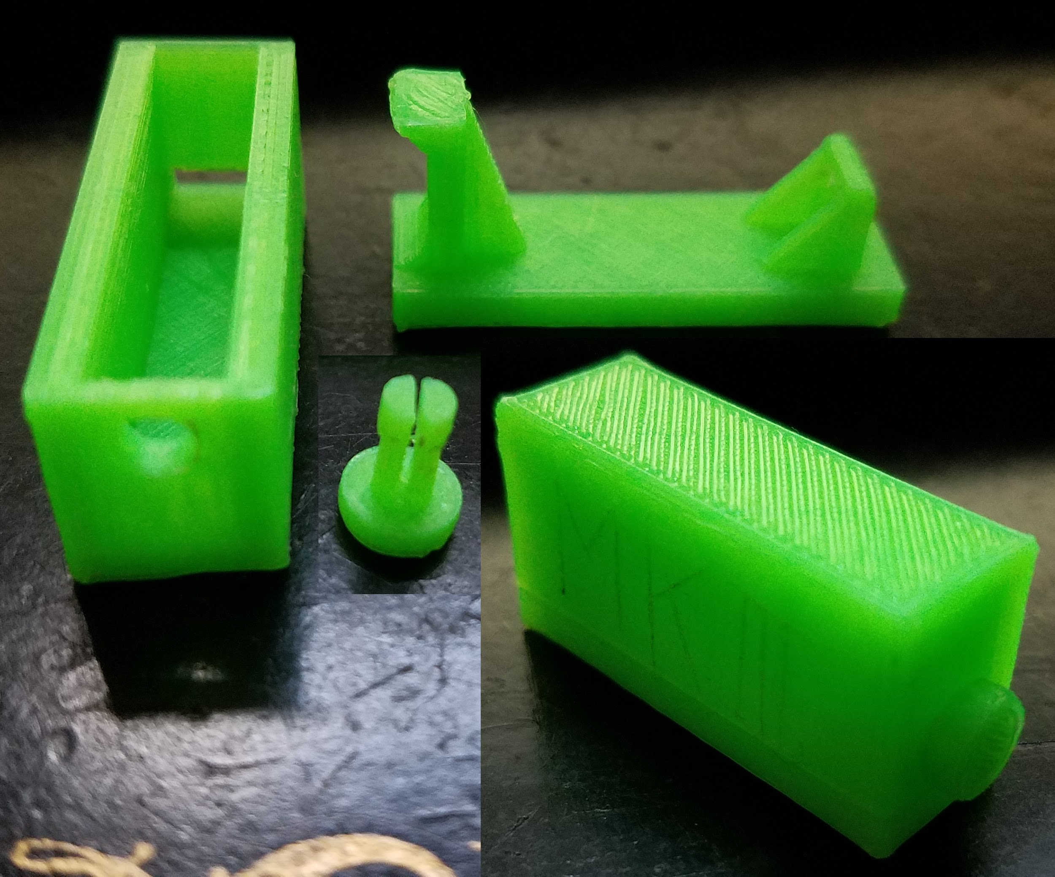
Implementation
3D printed case design
“Pin lock mechanism”
Also trial and error
Easy to implement
Very strong and easy to use
Successful

Slide 13
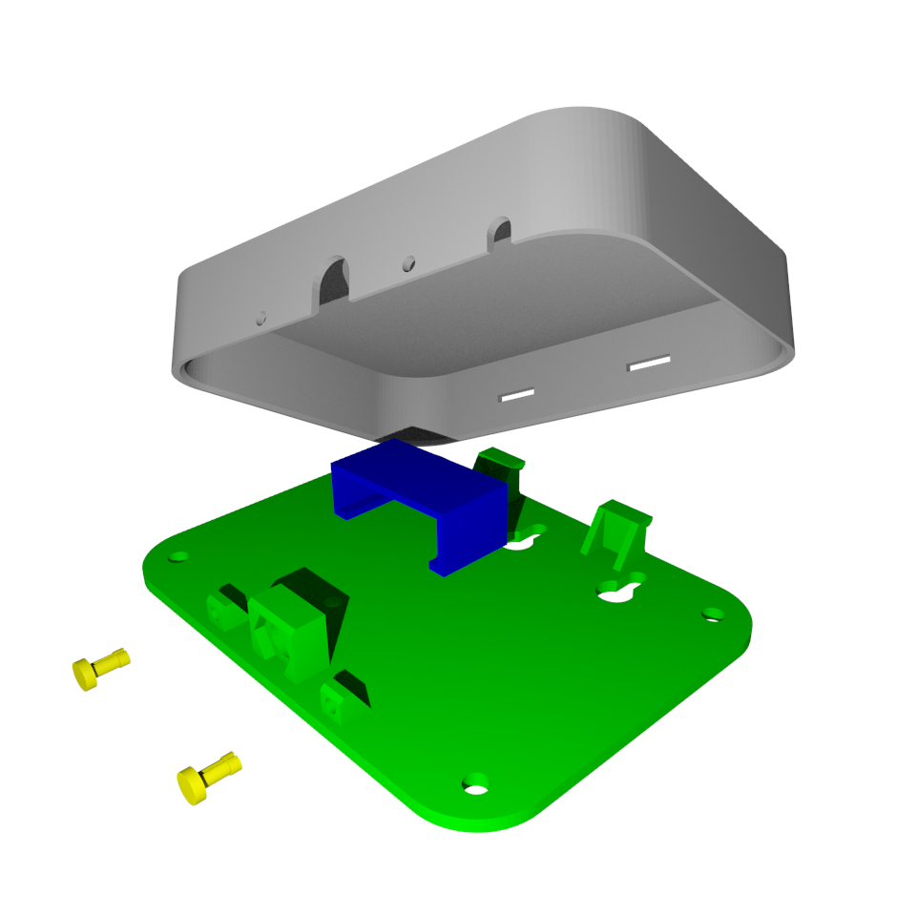
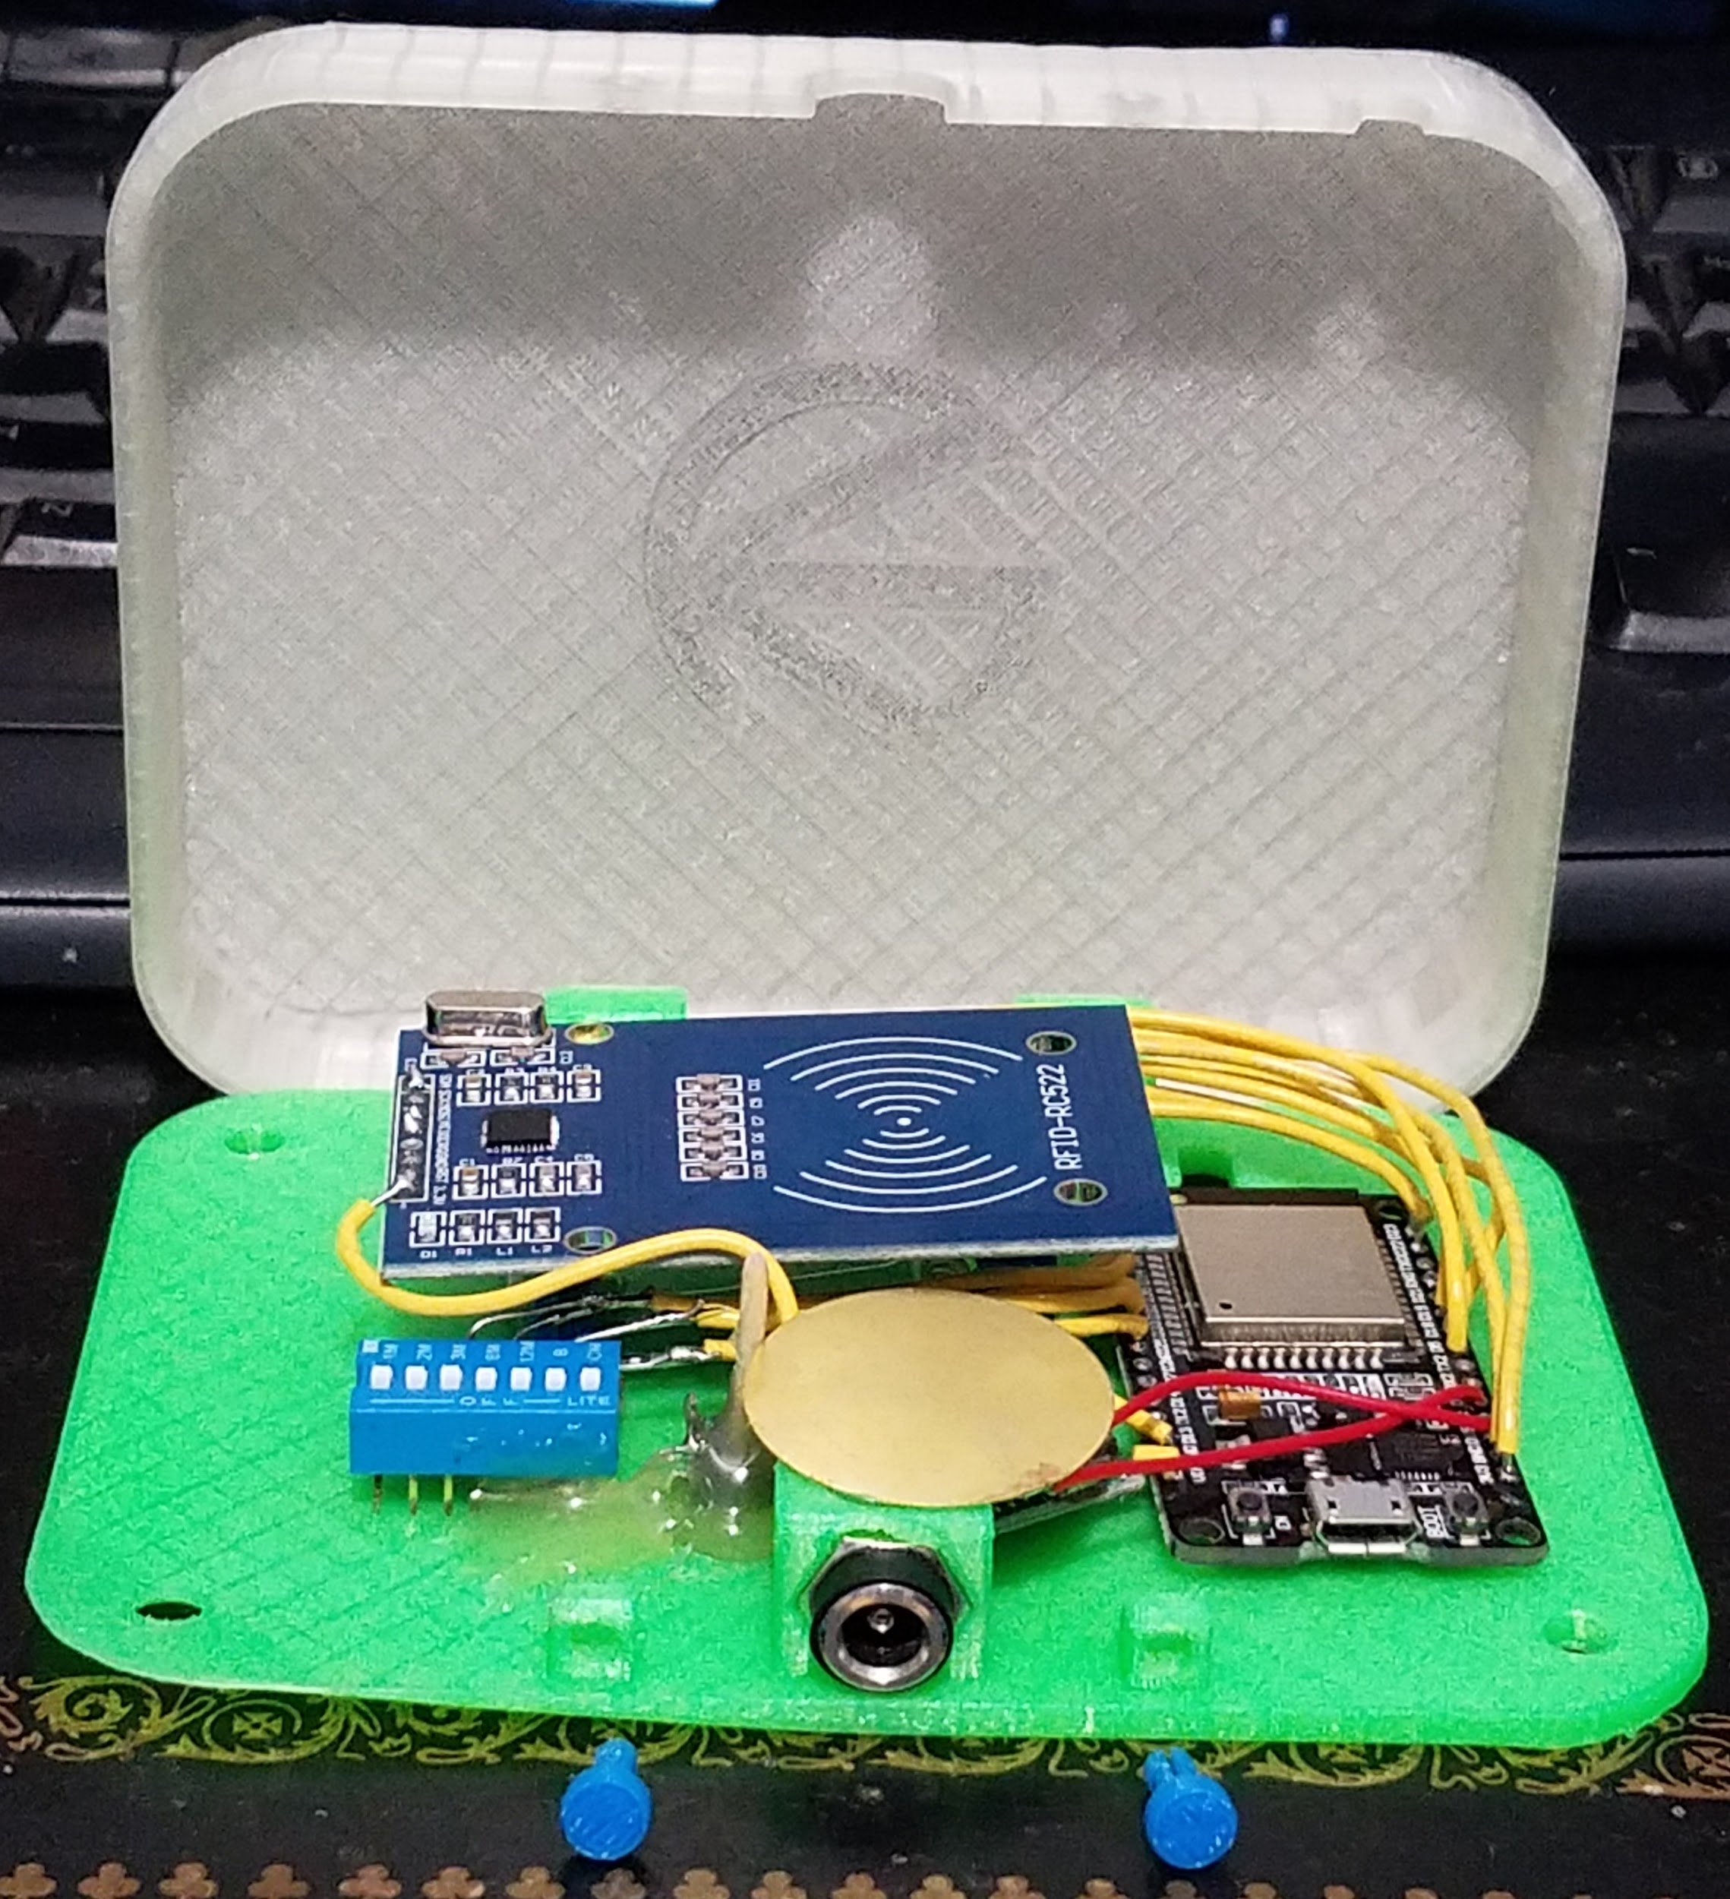
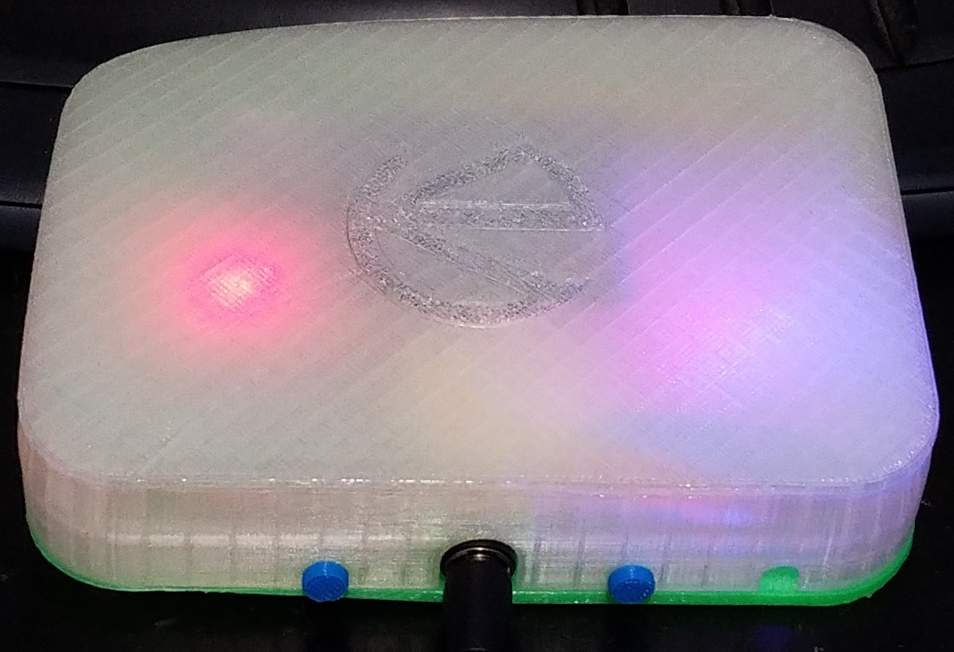
Implementation
Final case design
Using pin lock
23 hours of printing
5 hours of assembly
Point to point style

Slide 14
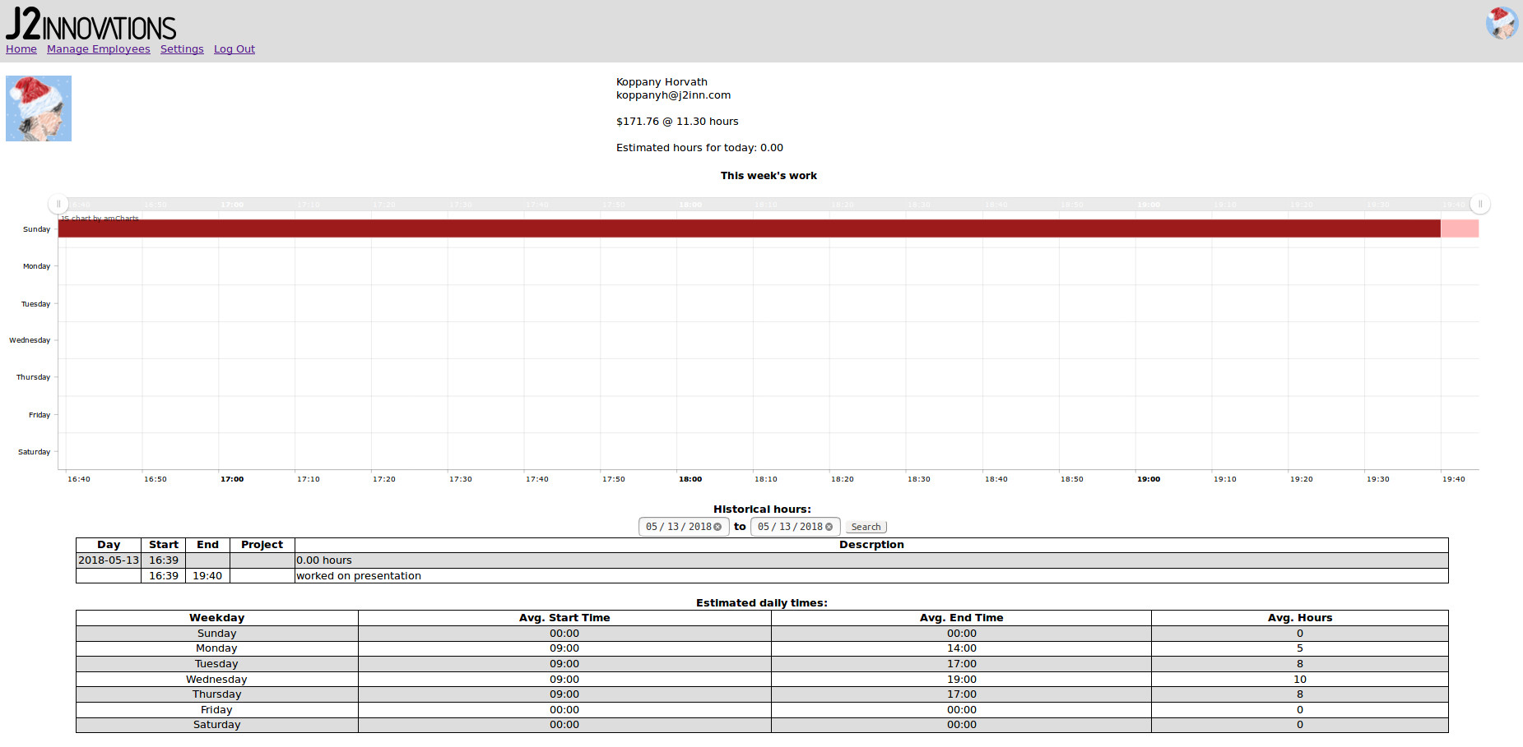
Implementation
Profile page
Work chart
Historical data
Estimated times
Profile pic
Update API

Slide 15
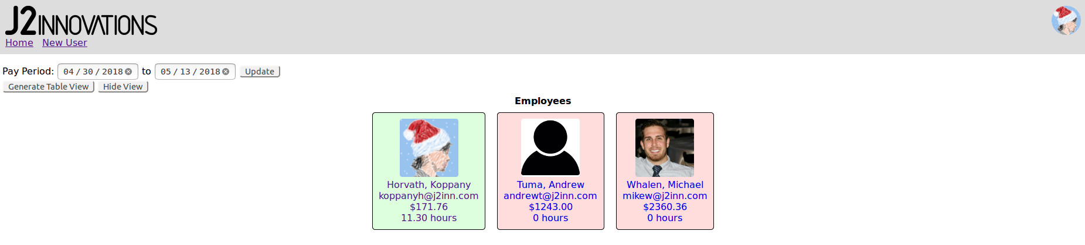
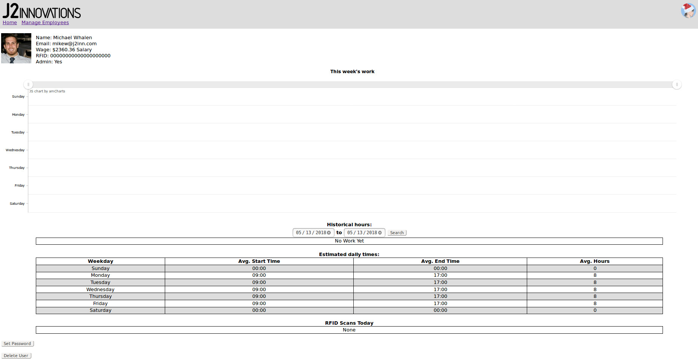
Implementation
User Management
View all users
See who’s clocked in
See profiles
Edit profiles
More API updates

Slide 16
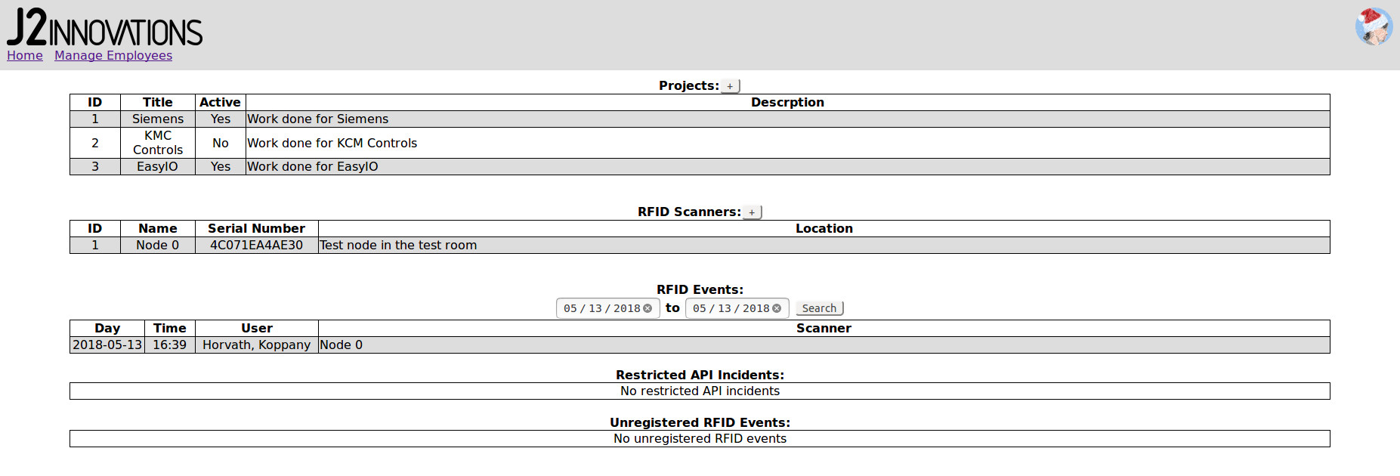
Implementation
Settings
Add / edit projects
Add / edit RFID scanners
View RFID events
View incidents
Even more API updates
Updates to database

Slide 17
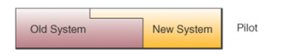
Implementation
End user training
Minimal for the employees
Slightly more for management
Setting up an RFID node
Using the management features in the UI
System conversion
Pilot method with 5 people for 1 week
Plunge method after 1 week
Follow up plan
Continuous / regular monitoring
UI and feature updates

Slide 18
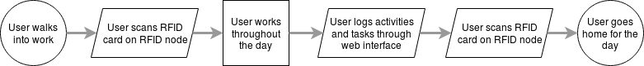
Operation
Operation
Maintenance
Occasional database backup / cleaning
Policy addition
No changes to policy

Slide 19

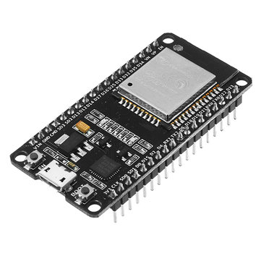
Lessons Learned
Asynchronous web programming
IOT firmware programming
Mechanical 3D printing design
REST API implementation

Slide 20

Limitations
WiFi on RFID node sometimes doesn’t work
UI sometimes slowed by database access time
UI bugs cause infinite loading bar

Slide 21

User Satisfaction
10 / 10 Employees satisfied (projected value)

Slide 22
If I Did It Again...
More compact case design
Better case interior
No warped corner on case
Better assembly technique
More effort to UI styling

Slide 23

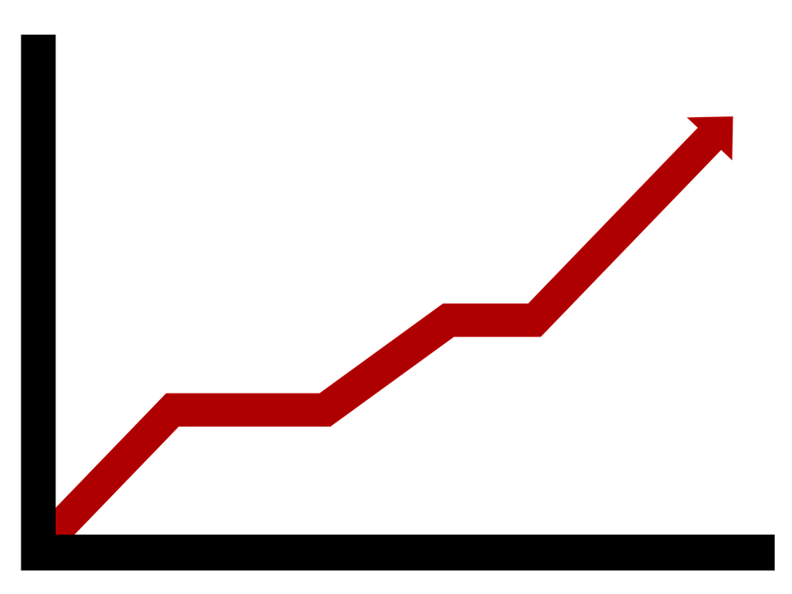
Future Expansion
Make a circular RFID node
Support multiple time zones
Dynamic reports / more charts for management
Track days off / vacation / sick days through the UI
Automatic server installer for easy setup

Slide 24
Conclusion
Learned a lot about product design
Learned a lot about web development
Came out exactly as I planned
Very few problems along the way
Overall very successful

Slide 25
Acknowledgements
CMPN 280: Computer Organization
CMPS 218: Publishing on the web 1
Professor Seta Whitby
Alvaro Alvarez

Slide 26
Demo

Slide 27

Questions?

